Slide 1
BASICS OF MECHANICAL ENGINEERING
By
Er.SISIRA KUMAR JAGADEV
(B.Tech in Mechanical Engineering from SOPHITORIUM ENGINEERING COLLEGE & M.Teh CUTM,Jatni)

Slide 2
UNIT-1 Thermodynamics can be defined as the study of energy, energy transformations and its relation to matter. The analysis of thermal systems is achieved through the application of the governing conservation equations, namely Conservation of Mass, Conservation of Energy (1st law of thermodynamics), the 2nd law of thermodynamics and the property relations. Energy can be viewed as the ability to cause changes.
MACROSCOPIC
MICROSCOPIC
Even the macroscopic properties which cannot be sensed by human can be related to the properties which can be sensed by the humans.
These relations can be established either by experiments or by theory at some macroscopic level.
In microscopic view we try to determine behavior of a system by the events happening at molecular level.
We can easily find that macroscopic behavior is always related to microscopic behavior because a matter is always comprised of molecules.
One can see that macroscopic behavior is an average of microscopic behavior of large number of molecules over a considerable period of time.

Slide 3
System:
A thermodynamic system is defined as a quantity of matter or a region in space which is selected for the study.
Suroundings:
The mass or region outside the system is called surroundings.
Boundary:
The real or imaginary surfaces which separates the system and surroundings is called boundary. The real or imaginary surfaces which separates the system and surroundings is called boundary.

Slide 4
Closed system: A system in which the transfer of energy but not mass can takes place across the boundary is called closed system. The mass inside the closed system remains constant.
For example: Boiling of water in a closed vessel. Since the water is boiled in closed vessel so the mass of water cannot escapes out of the boundary of the system but heat energy continuously entering and leaving the boundary of the vessel. It is an example of closed system.

Slide 5
Open system: A system in which the transfer of both mass and energy takes place is called an open system. This system is also known as control volume.
For example: Boiling of water in an open vessel is an example of open system because the water and heat energy both enters and leaves the boundary of the vessel.

Slide 6
Isolated system: A system in which the transfer of mass and energy cannot takes place is called an isolated system.
For example: Tea present in a thermos flask. In this the heat and the mass of the tea cannot cross the boundary of the thermos flask. Hence the thermos flak is an isolated system.

Slide 7
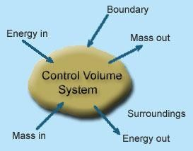
Control Volume:
Its a system of fixed volume.
This type of system is usually referred to as "open system” or a "control volume"
Mass transfer can take place across a control volume.
Energy transfer may also occur into or out of the system.
Control Surface- Its the boundary of a control volume across which the transfer of both mass and energy takes place.
The mass of a control volume (open system) may or may not be fixed.
When the net influx of mass across the control surface equals zero then the mass of the system is fixed and vice-versa.
The identity of mass in a control volume always changes unlike the case for a control mass system (closed system).
Most of the engineering devices, in general, represent an open system or control
volume.

Slide 8
Example:
Heat exchanger - Fluid enters and leaves the system continuously with the transfer of heat across the system boundary.Pump - A continuous flow of fluid takes place through the system with a transfer of mechanical energy from the surroundings to the system

Slide 9
Microscopic Approach:
The approach considers that the system is made up of a very large number of discrete particles known as molecules. These molecules have different velocities are energies. The values of these energies are constantly changing with time. This approach to thermodynamics, which is concerned directly with the structure of the matter, is known as statistical thermodynamics.
The behavior of the system is found by using statistical methods, as the number of molecules is very large. So advanced statistical and mathematical methods are needed to explain the changes in the system.
The properties like velocity, momentum, impulse, kinetic energy and instruments cannot easily measure force of impact etc. that describe the molecule.
Large numbers of variables are needed to describe a system. So the approach is complicated.

Slide 10
Macroscopic Approach:
In this approach a certain quantity of matter is considered without taking into account the events occurring at molecular level. In other words this approach to thermodynamics is concerned with gross or overall behavior. This is known as classical thermodynamics.
The analysis of macroscopic system requires simple mathematical formula.
The value of the properties of the system are their average values. For examples consider a sample of gas in a closed container. The pressure of the gas is the average value of the pressure exerted by millions of individual molecules.
In order to describe a system only a few properties are needed.

Slide 11
S.No | Macroscopic Approach | Microscopic Approach
1 | In this approach a certain quantity of matter is considered without taking into account the events occurring at molecular level. | The matter is considered to be comprised of a large number of tiny particles known as molecules, which moves randomly in chaotic fashion. The effect of molecular motion is considered.
2 | Analysis is concerned with overall behavior of the system. | The Knowledge of the structure of matter is essential in analyzing the behavior of the system.
3 | This approach is used in the study of classical thermodynamics. | This approach is used in the study of statistical thermodynamics.
4 | A few properties are required to describe the system. | Large numbers of variables are required to describe the system.
5 | The properties like pressure, temperature, etc. needed to describe the system, can be easily measured. | The properties like velocity, momentum, kinetic energy, etc. needed to describe the system, cannot be measured easily.
6 | The properties of the system are their average values. | The properties are defined for each molecule individually.

Slide 12
State:
The thermodynamic state of a system is defined by specifying values of a set of measurable properties sufficient to determine all other properties. For fluid systems, typical properties are pressure, volume and temperature. More complex systems may require the specification of more unusual properties. As an example, the state of an electric battery requires the specification of the amount of electric charge it contains.
Property:
Properties may be extensive or intensive.
Intensive properties: The properties which are independent of the mass of thesystem. For example: Temperature, pressure and density are the intensive properties.
Extensive properties: The properties which depend on the size or extent of the system are called extensive properties.
For example: Total mass, total volume and total momentum.

Slide 13
Process:
When the system undergoes change from one thermodynamic state to final state due change in properties like temperature, pressure, volume etc, the system is said to have undergone thermodynamic process.
Various types of thermodynamic processes are: isothermal process, adiabatic process, isochoric process, isobaric process and reversible process.
Cycle:
Thermodynamic cycle refers to any closed system that undergoes various changes due to temperature, pressure, and volume, however, its final and initial state are equal. This cycle is important as it allows for the continuous process of a moving piston seen in heat engines and the expansion/compression of the working fluid in refrigerators, for example. Without the cyclical process, a car wouldn't be able to continuously move when fuel is added, or a refrigerator would not be able to stay cold.
Visually, any thermodynamic cycle will appear as a closed loop on a pressure volume diagram.
Examples: Otto cycle, Diesel Cycle, Brayton Cycle etc.

Slide 14
Reversibility:
Reversibility, in thermodynamics, a characteristic of certain processes (changes of a system from an initial state to a final state spontaneously or as a result of interactions with other systems) that can be reversed, and the system restored to its initial state, without leaving net effects in any of the systems involved.
An example of a reversible process would be a single swing of a frictionless pendulum from one of its extreme positions to the other. The swing of a real pendulum is irreversible because a small amount of the mechanical energy of the pendulum would be expended in performing work against frictional forces, and restoration of the pendulum to its exact starting position would require the supply of an equivalent amount of energy from a second system, such as a compressed spring in which an irreversible change of state would occur.
Quasi static process:
When a process is processing in such a way that system will be remained infinitesimally close with equilibrium state at each time, such process will be termed as quasi static process or quasi equilibrium process.
In simple words, we can say that if system is going under a thermodynamic process through succession of thermodynamic states and each state is equilibrium state then the process will be termed as quasi static process.

Slide 15
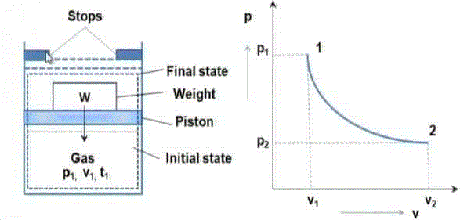
We will see one example for understanding the quasi static process, but let us consider one simple example for better understanding of quasi static process. If a person is coming down from roof to ground floor with the help of ladder steps then it could be considered as quasi static process. But if he jumps from roof to ground floor then it will not be a quasi static process.
Weight placed over the piston is just balancing the force which is exerted in upward direction by gas. If we remove the weight from the piston, system will have unbalanced force and piston will move in upward direction due to force acting over the piston in upward direction by the gas.

Slide 16
Irreversible Process:
The irreversible process is also called the natural process because all the processes occurring in nature are irreversible processes. The natural process occurs due to the finite gradient between the two states of the system. For instance, heat flow between two bodies occurs due to the temperature gradient between the two bodies; this is in fact the natural flow of heat. Similarly, water flows from high level to low level, current moves from high potential to low potential, etc.
In the irreversible process the initial state of the system and surroundings cannot be restored from the final state.
During the irreversible process the various states of the system on the path of change from initial state to final state are not in equilibrium with each other.
During the irreversible process the entropy of the system increases decisively and it cannot be reduced back to its initial value.
The phenomenon of a system undergoing irreversible process is called as irreversibility.

Slide 17
Causes of Irreversibility:
Friction: Friction is invariably present in real systems. It causes irreversibility in the process as work done does not show an equivalent rise in the kinetic or potential energy of the system. The fraction of energy wasted due to frictional effects leads to deviation from reversible states.
Free expansion: Free expansion refers to the expansion of unresisted type such as expansion in a vacuum. During this unresisted expansion the work interaction is zero, and without the expense of any work, it is not possible to restore initial states. Thus, free expansion is irreversible.
Heat transfer through a finite temperature difference: Heat transfer occurs only when there exist temperature difference between bodies undergoing heat transfer. During heat transfer, if heat addition is carried out in a finite number of steps then after every step the new state shall be a non-equilibrium state.
Nonequilibrium during the process: Irreversibilities are introduced due to lack of thermodynamic equilibrium during the process. Non-equilibrium may be due to mechanical inequilibrium, chemical inequilibrium, thermal inequilibrium, electrical inequilibrium, etc. and irreversibility is called mechanical irreversibility, chemical irreversibility, thermal irreversibility, electrical irreversibility respectively. Factors discussed above are also causing non-equilibrium during the process and therefore make process irreversible.

Slide 18
Heat:
It is the energy in transition between the system and the surroundings by virtue of the difference in temperature Heat is energy transferred from one system to another solely by reason of a temperature difference between the systems. Heat exists only as it crosses the boundary of a system and the direction of heat transfer is from higher temperature to lower temperature. For thermodynamics sign convention, heat transferred to a system is positive; Heat transferred from a system is negative.
Work:
Thermodynamic definition of work: Positive work is done by a system when the sole effect external to the system could be reduced to the rise of a weight.
Work done BY the system is positive and work done ON the system is negative.

Slide 19
Types of work interaction:
Expansion and compression work (displacement work)
Work of a reversible chemical cell
Work in stretching of a liquid surface
Work done on elastic solids
Work of polarization and magnetization
Point and Path functions:
Point function does not depend on the history (or path) of the system. It only depends on the state of the system.
Examples of point functions are: temperature, pressure, density, mass, volume, enthalpy, entropy, internal energy etc.
Path function depends on history of the system (or path by which system arrived at a given state).
Examples for path functions are work and heat.
Path functions are not properties of the system, while point functions are properties of the system.
Change in point function can be obtained by from the initial and final values of the function, whereas path has to defined in order to evaluate path functions.

Slide 20
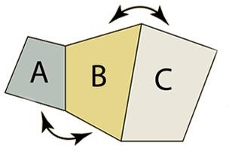
Zeroth Law of Thermodynamics:
The Thermodynamics Zeroth Law states that if two systems are at the same time in thermal equilibrium with a third system, they are in equilibrium with each other.
If an object with a higher temperature comes in contact with an object of lower temperature, it will transfer heat to the lower temperature object. The objects will approach the same temperature and in the absence of loss to other objects, they will maintain a single constant temperature. Therefore, thermal equilibrium is attained.

Slide 21
If objects ‘A’ and ‘C’ are in thermal equilibrium with ‘B’, then object ‘A’ is in thermal equilibrium with object ‘C’. Practically this means all three objects are at the same temperature and it forms the basis for comparison of temperatures.
Principles of Thermometry:
Thermometry is the science and practice of temperature measurement. Any measurable change in a thermometric probe (e.g. the dilatation of a liquid in a capillary tube, variation of electrical resistance of a conductor, of refractive index of a transparent material, and so on) can be used to mark temperature levels, that should later be calibrated against an internationally agreed unit if the measure is to be related to other thermodynamic variables. Thermometry is sometimes split in metrological studies in two subfields: contact thermometry and noncontact thermometry. As there can never be complete thermal uniformity at large, thermometry is always associated to a heat transfer problem with some space-time coordinates of measurement, given rise to time-series plots and temperature maps.

Slide 22
Internal Energy
Through, Joule experiment what happen to energy between time it is added to water as work, and time it is extracted to heat? Logic suggests that this energy contained in the water in another form which called internal energy.
Internal energy refers to energy of molecules of substance which are ceaseless motion and possess kinetics energy. The addition of heat to a substance increases this molecular activity, and thus causes an increase in its internal energy. Work done on the substance can have the same effect, as was shown by Joule. Internal energy cannot be directly measured; there are no internal-energy meters. As a result, absolute values are unknown. However, this is not a disadvantage in thermodynamic analysis, because only changes in internal energy are required.

Slide 23
First Law of Thermodynamics:
During a thermodynamic cycle, a cyclic process the systems undergoes, the cyclic integral of heat added is equal to integral of work done. The first law equation can also be written in the form,
§(dQ – dW) = 0
Equation dU = dQ – dW is a corollary to the first law of thermodynamics. It shows that there exists a property internal energy (U) of the system, such that a change in its value is equal to the difference in heat entering and work leaving the system.
The First law of thermodynamics states that energy is neither created nor destroyed. Thus the total energy of the universe is a constant. However, energy can certainly be transferred from one form to another form.
The 1st law of thermodynamics can be mathematically stated as follows:
§dQ = §dW

Slide 24
Flow Process
Steady flow energy equation:
Virtually all the practical systems involve flow of mass across the boundary separating the system and the surroundings. Whether it be a steam turbine or a gas turbine or a compressor or an automobile engine there exists flow of gases/gas mixtures into and out of the system. So we must know how the first Law of thermodynamics can be applied to an open system.
The fluid entering the system will have its own internal, kinetic and potential energies.
Let u1 be the specific internal energy of the fluid entering C₁ be the velocity of the fluid while entering Z₁ be the potential energy of the fluid while entering Similarly let u₂, C₂ and Z₂ be respective entities while leaving.

Slide 25
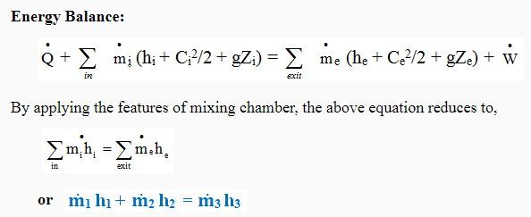

Slide 26
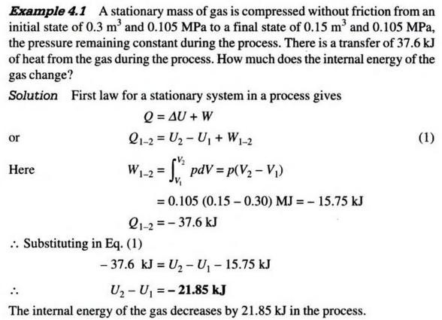

Slide 27
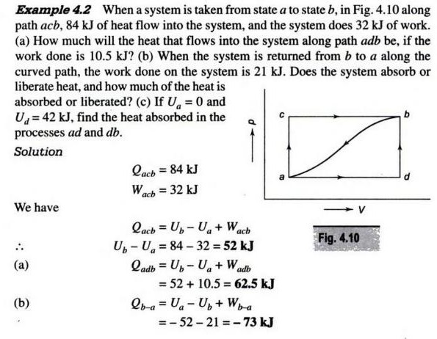

Slide 28
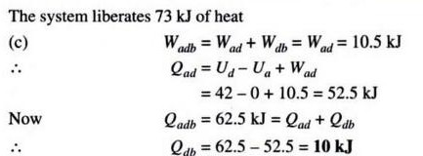

Slide 29
Limitations of the First Law:
The first law of thermodynamics merely indicates that in any process there is a transformation between the various forms of energy involved in the process but provides no information regarding the feasibility of such transformation.
First law does not provide any information regarding the direction processes will take
whether it is a spontaneous or a non spontaneous process.
Heat Engine:
It is a cyclically operating device which absorbs energy as heat from a high temperature reservoir, converts part of the energy into work and rejects the rest of the energy as heat to a thermal reservoir at low temperature.
The working fluid is a substance, which absorbs energy as heat from a source, and rejects energy as heat to a sink.

Slide 30
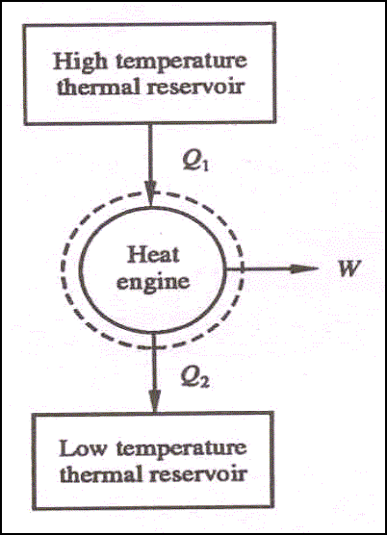

Slide 31
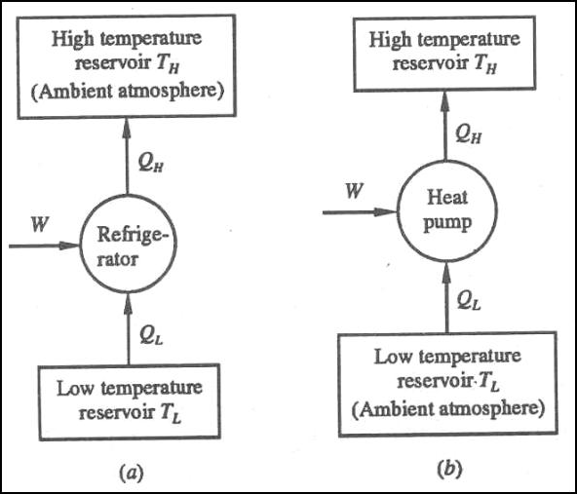
Heat pump:
A heat pump is a device that transfers heat energy from a source of heat to what is called a heat sink. Heat pumps move thermal energy in the opposite direction of spontaneous heat transfer, by absorbing heat from a cold space and releasing it to a warmer one. A heat pump uses a small amount of external power to accomplish the work of transferring energy from the heat source to the heat sink. The most common design of a heat pump involves four main components – a condenser, an expansion valve, an evaporator and a compressor. The heat transfer medium circulated through these components is called refrigerant.

Slide 32
Coefficient of Performance
The coefficient of performance, COP, of a refrigerator is defined as the heat removed from the cold reservoir Qcold, (i.e. inside a refrigerator) divided by the work W done to remove the heat (i.e. the work done by the compressor).
COP - coefficient of performance - equation
As can be seen, the better (more efficient) the refrigerator is when more heat Qcold can be removed from the inside of the refrigerator for a given amount of work. Since the first law of thermodynamics must be valid also in this case (Qcold + W = Qhot), we can rewrite the above equation:

Slide 33
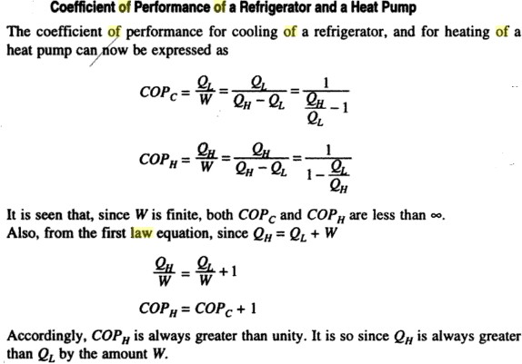
The COP for heating and cooling are thus different, because the heat reservoir of interest is different. When one is interested in how well a machine cools, the COP is the ratio of the heat removed from the cold reservoir to input work. However, for heating, the COP is the ratio of the heat removed from the cold reservoir plus the input work to the input work: medium to a high-temperature is called heat pump.

Slide 34
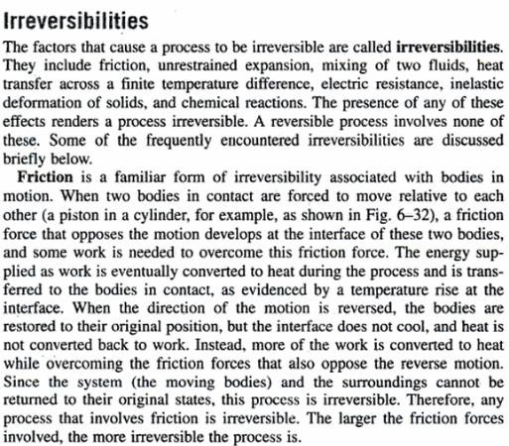

Slide 36
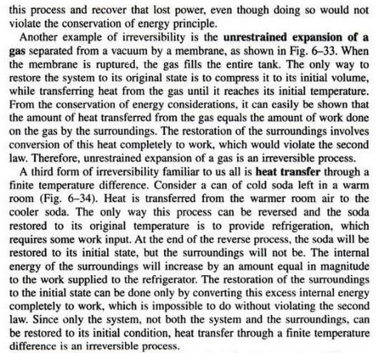

Slide 37
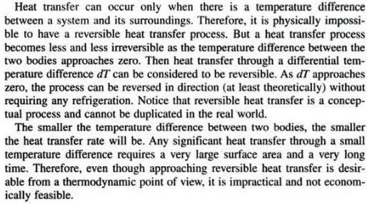

Slide 39
The ideal gas law states that the product of the pressure and the volume of one gram molecule of an ideal gas is equal to the product of the absolute temperature of the gas and the universal gas constant.
PV=nRT
where, P is the pressure V is the volume n is the amount of substance R is the ideal gas constant

Slide 40
Derivation of the Ideal Gas Law
The ideal gas law is derived from the observational work of Robert Boyle, Gay-Lussac and Amedeo Avogadro. Combining their observation into a single expression we arrive at the Ideal gas equation which describes all the relationships simultaneously.
The three individual expressions are as follows:
Boyle’s Law V∝1P
Charle’s Law V∝T
Avagadro’s Law V∝n
Combining these three expressions, we get
V∝nTP
The above equation shows that volume is proportional to the number moles and the temperature while inversely proportional to the pressure.
This expression can be rewritten as follows:
V=RnTP=nRTP
Multiplying both sides of the equation by P to clear off the fraction, we get
PV=nRT
The above equation is known as the ideal gas equation.
Ideal Gas Solved Problems
1. What is the volume occupied by 2.34 grams of carbon dioxide gas at STP? Solution: To determine the volume, rearrange the ideal gas law as follows: V=nRT/P Substituting the values as follows, we get V=[(2.34g/44g.mol−1)(0.08206Latmmol−1K−1)(273.0K)]/1.00atm V=1.19L
2. Calculate the temperature at which 0.654 moles of neon gas occupies 12.30 litres at 1.95 atmospheres. Solution: To determine the temperature, rearrange the ideal gas equation as follows: T=PV/nR Substituting the value, we get T=(1.95atm))(12.30L)/(0.654mol)(0.08206Latmmol−1K−1) T=447K

Slide 41
UNIT-2
Applications of Thermodynamics
All types of vehicles that we use, cars, motorcycles, trucks, ships, aeroplanes, and many other types work on the basis of second law of thermodynamics and Carnot Cycle. They may be using petrol engine or diesel engine, but the law remains the same.
All the refrigerators, deep freezers, industrial refrigeration systems, all types of air-conditioning systems, heat pumps, etc work on the basis of the second law of thermodynamics.
All types of air and gas compressors, blowers, fans, run on various thermodynamic cycles.
One of the important fields of thermodynamics is heat transfer, which relates to transfer of heat between two media. There are three modes of heat transfer: conduction, convection and radiation. The concept of heat transfer is used in wide range of devices like heat exchangers, evaporators, condensers, radiators, coolers, heaters, etc.
Thermodynamics also involves study of various types of power plants like thermal power plants, nuclear power plants, hydroelectric power plants, power plants based on renewable energy sources like solar, wind, geothermal, tides, water waves etc,
Renewable energy is an important subject area of thermodynamics that involves studying the feasibility of using different types of renewable energy sources for domestic and commercial use.

Slide 42
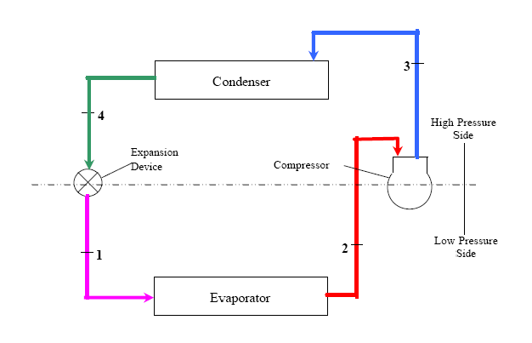
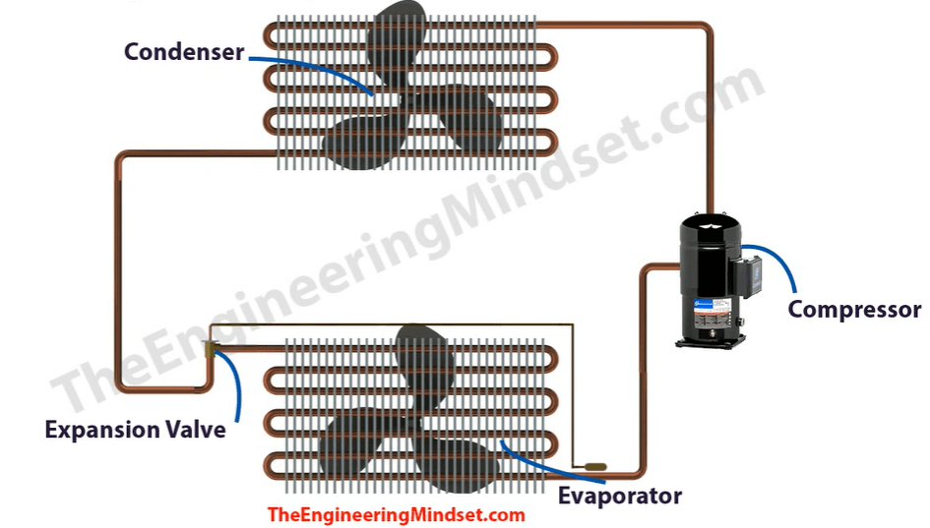
Refrigeration is a process of achieving and maintaining a low temperature below that of surroundings

Slide 43
The compressor
Compression is the first step in the refrigeration cycle, and a compressor is the piece of equipment that increases the pressure of the working gas. Refrigerant enters the compressor as low-pressure, low-temperature gas, and leaves the compressor as a high-pressure, high-temperature gas.
Types of compressors
Compression can be achieved through a number of different mechanical processes, and because of that, several compressor designs are used in HVAC and refrigeration today. Other examples exist, but some popular choices are:
1. Reciprocating compressors
2. Scroll compressors
3. Rotary compressors

Slide 44
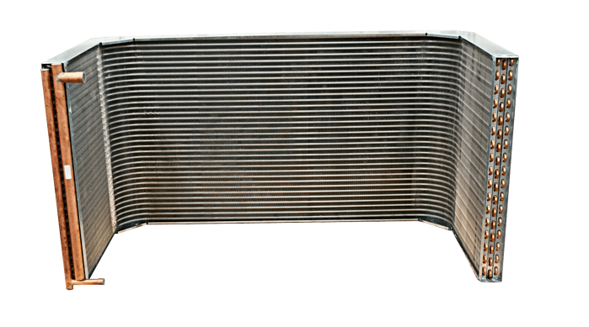
The condenser
The condenser, or condenser coil, is one of two types of heat exchangers used in a basic refrigeration loop. This component is supplied with high-temperature high-pressure, vaporized refrigerant coming off the compressor. The condenser removes heat from the hot refrigerant vapor gas vapor until it condenses into a saturated liquid state, a.k.a. condensation.
After condensing, the refrigerant is a high-pressure, low-temperature liquid, at which point it’s routed to the loop’s expansion device.

Slide 45
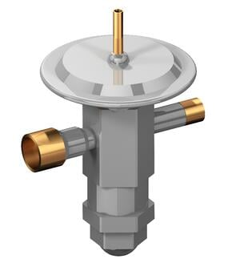
The expansion device
These components come in a few different designs. Popular configurations include fixed orifices, thermostatic expansion valves (TXV) or thermal expansion valves (pictured above), and the more advanced electronic expansion valves (EEVs). But regardless of configuration, the job of a system’s expansion device is the same - create a drop in pressure after the refrigerant leaves the condenser. This pressure drop will cause some of that refrigerant to quickly boil, creating a two-phase mixture.
This rapid phase change is called flashing, and it helps tee up the next piece of equipment in the circuit, the evaporator, to perform its intended function.

Slide 46
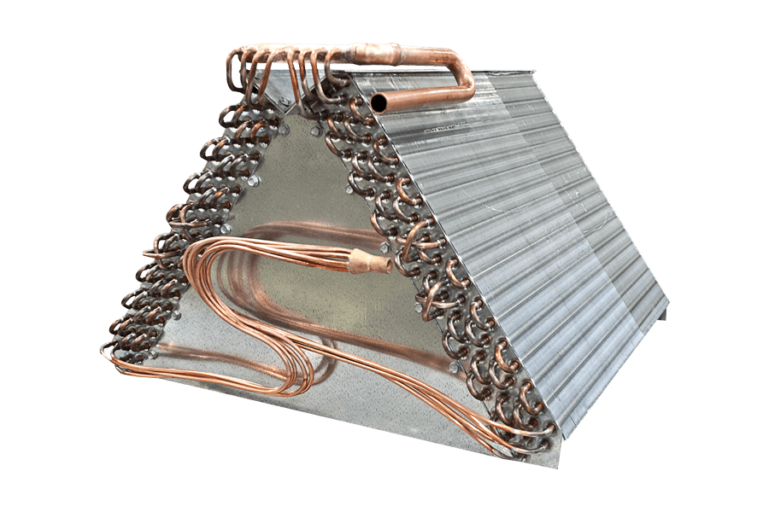
The evaporator
The evaporator is the second heat exchanger in a standard refrigeration circuit, and like the condenser, it’s named for its basic function. It serves as the “business end” of a refrigeration cycle, given that it does what we expect air conditioning to do – absorb heat.
This happens when refrigerant enters the evaporator as a low temperature liquid at low pressure, and a fan forces air across the evaporator’s fins, cooling the air by absorbing the heat from the space in question into the refrigerant.
After doing so, the refrigerant is sent back to the compressor, where the process restarts. And that, in a nutshell, is how a refrigeration loop works. If you have any questions about the refrigeration cycle or its components and how they work, give us a call. We've been helping customers get the most out of their HVAC and refrigeration equipment for nearly 100 years.

Slide 47
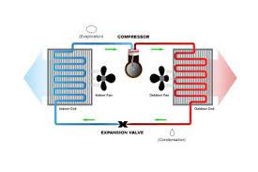
what is heat pump system?
A heat pump can provide an alternative to using your air conditioner. ... They collect heat from the air, water, or ground outside your home and concentrate it for use inside. The most common type of heat pump is the air-source heat pump, which transfers heat between your house and the outside air.
A heat pump is a versatile, efficient cooling and heating system. Thanks to a reversing valve, a heat pump can change the flow of refrigerant and either heat or cool a home. Air is blown over an evaporator coil, transferring heat energy from the air to the refrigerant.

Slide 48
UNIT -3
Engine. Both IC and EC engines are of two types, i.e. Reciprocating and Rotary engine. I.C. Engine, an acronym for an internal combustion engine is the engine in which ignition and combustion of fuel take place inside the engine.
I.C.Engine, an acronym for an internal combustion engine is the engine in which ignition and combustion of fuel take place inside the engine. It works on the principle that the charge is ignited inside a combustion chamber under very high pressure.
A diesel engine is an example of it where the working fluid is air. This engine is widely applied in automotive, aviation, power generation, etc. The engine consists of various components viz. cylinder, spark plug, valves, piston, piston rings, connecting rod, crankshaft, and oil pan(sump).

Slide 49
(On the basis of types of ignition) : a spark-ignition gasoline engine and compression ignition diesel engine. In the spark-ignition engine, the fuel is mixed with air and introduced into the cylinder during the intake process.
As the piston compresses the mixture, there ignites a spark that led to the combustion process. during the power stroke, combustion gases expand and push the piston. Whereas, in the diesel engine, only air is introduced and then compressed. Afterward, the engine sprays the fuel into the hot compressed air which causes the ignition.
(On the basis of the number of strokes): two-stroke engine and four-stroke engine. Most of the engine uses the four-stroke engine, that means four piston strokes are required to complete a cycle. This cycle includes four processes: intake, compression, combustion and power stroke and exhaust.
Various advancements are done nowadays like advancements in the design of the engine, fuel injection, materials to be used, etc to improve the fuel efficiency, less weight of the vehicle, less pollution, and lower emission.

Slide 50
1. NUMBER OF STROKES PER CYCLE:
A) FOUR-STROKE CYCLE ENGINE:
This engine makes four piston strokes i.e. intake, compression, power and exhaust to complete an operating cycle. The operating cycle requires two crankshaft revolutions( 720 degrees). It is the most common type of engine used in automotive.
B) TWO-STROKE CYCLE ENGINE:
As per the name, this engine requires two piston strokes to complete an operating cycle. Those strokes are compression and expansion strokes. Only one crankshaft rotation is required.
C) SIX STROKE CYCLE ENGINE:
This engine is introduced to make some advancements in conventional two-stroke and four-stroke engines. It increases the efficiency of fuel, reduces emissions, etc. In this engine, one of the cylinders makes two strokes and others makes four strokes, in total making six strokes per cycle.

Slide 51
2. NATURE OF THERMODYNAMIC CYCLE:
A) OTTO CYCLE ENGINE
Otto cycle is an idealized cycle for SI engines.
It consists of two quasistatic and isentropic processes and two isochoric processes. The engine which follows this thermodynamic cycle for operation is known as otto cycle engine.
B) DIESEL CYCLE ENGINE
Diesel cycle is an idealized cycle for a diesel engine which consists of two isentropic processes, one isobaric and one isochoric process.
C) DUAL CYCLE ENGINE
Dual cycle or mixed cycle or limited pressure cycle is the combination of otto and diesel cycle. Heat addition is partially through constant volume and constant pressure process. The internal combustion engine which follows this cycle is called, dual cycle engine.

Slide 52
3. TYPES OF FUEL USED
A) PETROL OR GASOLINE ENGINE
This engine generates power by burning gasoline (or other volatile liquid fuel with similar properties) ignited by an electric spark. Generally, a mixture of fuel and air is used as a charge.
B) DIESEL ENGINE
This engine makes use of diesel as fuel, where fuel ignition takes place on its own, without any spark. Hence, compression of the inlet air mixture takes place and then fuel is injected.
C) BI-FUEL ENGINE
This engine is a more advanced version of the otto engine. This engine can run on either natural gas or gasoline which means it follows the natural gas system and gasoline system i.e dual fuelling system. Hence these kinds of engines are known as bi-fuel or dual-fuel engines.

Slide 53
4. METHOD OF IGNITION
A)SPARK IGNITION ENGINE
in S.I engines, the ignition takes place with the help of a spark plug. This mechanical device called spark plug ignites a mixture of air and fuel( charge) which is compressed and combusted in the combustion chamber.
B) COMPRESSION IGNITION ENGINE
A CI engine follows the auto-ignition or self-ignition process where fuel charge is ignited by its own heat of compression. Here, the air is inducted into the combustion chamber and compressed to extremely high pressure. Hence the compression ratio of this engine is high(up to 22).

Slide 54
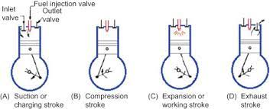
5. NUMBER OF CYLINDERS
A) SINGLE-CYLINDER ENGINE
It is a basic piston-cylinder configuration of an engine in which only one engine cylinder is used. The designing of this engine is compact and simple.
B) MULTI CYLINDER ENGINE
Here, more than one cylinder system is used. It is used to provide a more continuous flow of power. A popular multi-cylinder engine contains four, six, and eight engines in various configurations.

Slide 55
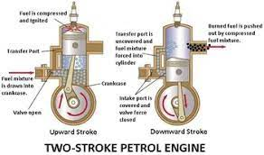

Slide 57
Introduction A fluid cannot resist a shear stress by a static deflection and it moves and deforms continuously as long as the shear stress is applied. Fluid mechanics is the study of fluids either in motion (fluid dynamics) or at rest (fluid statics). Both liquids and gases are classified as fluids. There is a theory available for fluid flow problems, but in all cases it should be backed up by experiment. It is a highly visual subject with good instrumentation. Since the earth is 75% covered with water and 100% with air, the scope of fluid mechanics is vast and has numerous applications in engineering and human activities. Examples are medical studies of breathing and blood flow, oceanography, hydrology, energy generation. Other engineering applications include: fans, turbines, pumps, missiles, airplanes to name a few. The basic equations of fluid motion are too difficult to apply to arbitrary geometric configurations. Thus most textbooks concentrate on flat plates, circular pipes, and other simple geometries. It is possible to apply numerical techniques to complex geometries, this branch of fluid mechanics is called computational fluid mechanics (CFD). Our focus, however, will be on theoretical approach in this course. Viscosity is an internal property of a fluid that offers resistance to flow. Viscosity increases the difficulty of the basic equations. It also has a destabilizing effect and gives rise to disorderly, random phenomena called turbulence.

Slide 58
Viscosity is an internal property of a fluid that offers resistance to flow. Viscosity increases the difficulty of the basic equations. It also has a destabilizing effect and gives rise to disorderly, random phenomena called turbulence. Fig.1: effects of viscosity and shape on the fluid flow.

Slide 59
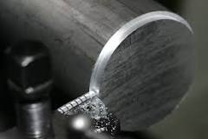
UNIT-4
What is the turning process?
Turning is a machining process in which a cutting tool, typically a non-rotary tool bit, describes a helix toolpath by moving more or less linearly while the workpiece rotates. ... Thus the phrase "turning and boring" categorizes the larger family of processes known as lathing.

Slide 60
Casting manufacturing is a process in which liquefied material, such as molten metal, is poured into the cavity of a specially designed mold and allowed to harden. After solidification, the workpiece is removed from the mold to undergo various finishing treatments or for use as a final product. Casting methods are typically used to create intricate solid and hollow shapes, and cast products are found in a wide range of applications, including automotive components, aerospace parts, etc.
Different Types of Casting and the Casting Process
Although casting is one of the oldest known manufacturing techniques, modern advances in casting technology have led to a broad array of specialized casting methods. Hot forming processes, such as die-casting, investment casting, plaster casting, and sand casting, each provide their own unique manufacturing benefits. Comparing both the advantages and disadvantages of the common types of casting processes can help in selecting the method best suited for a given production run.

Slide 61
Sand Casting
Sand casting typically relies on silica-based materials, such as synthetic or naturally-bonded sand. Casting sand generally consists of finely ground, spherical grains that can be tightly packed together into a smooth molding surface. The casting is designed to reduce the potential for tearing, cracking, or other flaws by allowing a moderate degree of flexibility and shrinkage during the cooling phase of the process. The sand can also be strengthened with the addition of clay, which helps the particles bond more closely. Automotive products such as engine blocks are manufactured through sand casting.
Sand casting involves several steps, including patternmaking, molding, melting and pouring, and cleaning. The pattern is the form around which the sand is packed, usually in two parts, the cope and the drag. After the sand is compacted enough to replicate the pattern, the cope is removed and the pattern extracted. Then, any additional inserts called core boxes are installed and the cope is replaced. After the metal has been poured and solidified, the casting is removed, trimmed of the risers and gates that were used in the pouring process, and cleaned of any adhered sand and scale.

Slide 62
Sand casting's main advantages as a casting process include:
Relatively inexpensive production costs, especially in low-volume runs.
The ability to fabricate large components.
A capacity for casting both ferrous and non-ferrous materials.
A low cost for post-casting tooling.
Despite its benefits, sand casting yields a lower degree of accuracy than do alternate methods and it can be difficult to sand cast components with a predetermined size and weight specifications. Furthermore, this process has a tendency to yield products with a comparatively rough surface finish.
You can use the Thomas Supplier Discovery Platform to find Sand Casting Companies for your needs.

Slide 63
Investment Casting
Investment, or lost-wax, casting uses a disposable wax pattern for each cast part. The wax is injected directly into a mold, removed, then coated with refractory material and a binding agent, usually in several stages to build up a thick shell. Multiple patterns are assembled onto common sprues. Once the shells have hardened the patterns are inverted and heated in ovens to remove the wax. Molten metal is then poured into the remaining shells where it hardens into the shape of the wax patterns. The refractory shell is broken away to reveal the completed casting. Investment casting is often used to manufacture parts for the automotive, power generation, and aerospace industries, such as turbine blades. Some of the central advantages and disadvantages of investment casting include:
A high degree of accuracy and precise dimensional results.
The ability to create thin-walled parts with complex geometries.
The capacity for casting both ferrous and non-ferrous materials.
Relatively high-quality surface finish and detail in final components.
Although it is highly precise, investment casting is usually more expensive than other comparable casting techniques and is typically only cost-efficient when sand or plaster castings cannot be used. However, the expense can sometimes be compensated for with reduced machining and tooling costs due to investment castings’ quality surface results.
You can use the Thomas Supplier Discovery Platform to find Investment Casting Companies for your needs.

Slide 64
Plaster Casting
Plaster casting is similar to the sand casting process, using a mixture of gypsum, strengthening compound, and water in place of the sand. The plaster pattern is typically coated with an anti-adhesive compound to prevent it from becoming stuck against the mold, and the plaster is capable of filling in any gaps around the mold. Once the plaster material has been used to cast the part, it usually cracks or forms defects, requiring it to be replaced with fresh material. The advantages offered by plaster casting include:
A very smooth surface finish.
The ability to cast complex shapes with thin walls.
The capacity for forming large parts with less expense than other processes, such as investment casting.
A higher degree of dimensional accuracy than that of sand casting.
This process tends to be more expensive than most sand casting operations and may require frequent replacements of the plaster molding material. It is usually more effective and cost-efficient when the quality of the surface finish is an important requirement. Its application is generally limited to casting aluminum and copper-based alloys.

Slide 65
Die Casting (Metal Casting Process)
Die casting is a method of molding materials under high pressure and usually involves non-ferrous metals and alloys, such as zinc, tin, copper, and aluminum. The reusable mold is coated with a lubricant to help regulate the die’s temperature and to assist with component ejection. Molten metal is then injected into the die under high pressure, which remains continuous until the workpiece solidifies. This pressurized insertion is rapid, preventing any segment of the material from hardening before being cast. After the process is completed, the component is taken out of the die and any scrap material is removed. A few of the major advantages provided by die casting include:
Close size and shape tolerances.
High component dimensional consistency and uniform design.
A reduced need for post-casting machining.
Despite its advantages, die casting as a metal casting process has relatively high tool costs, making it more cost-efficient in high-volume product runs. It can also be difficult to ensure the mechanical properties of a die-cast component, meaning these products usually do not function as structural parts. As the molds are typically two-piece, die casting is limited to products that can be removed from the mold without destroying the mold, as is done in other casting processes.
For more information on Die Casting, you can review our Types of Die Casting guide, which goes into depth on the various types, alloys, and considerations for choosing a specific process/alloy combination.

Slide 66
Centrifugal Casting
Centrifugal casting is used to produce long, cylindrical parts such as cast iron pipe by relying on the g-forces developed in a spinning mold. Molten metal introduced into the mold is flung against the interior surface of the mold, producing a casting that can be free of voids. Originally invented as the de Lavaud process using water-cooled molds, the method is applied to symmetrical parts such as soil pipe and large gun barrels and has the advantage of producing parts using a minimal number of risers. For asymmetric parts that cannot be spun around their own axes, a variant of centrifugal casting, called pressure casting, arranges several parts around a common sprue and spins the molds around this axis. A similar idea is applied to the casting of very large gear rings, etc. Depending on the material being cast, metal or sand molds may be used.

Slide 67
Permanent Mold Casting
Permanent mold casting shares similarities with die casting and centrifugal casting, notably the use of reusable molds. These can be made of steel, graphite, etc. and are generally used to cast materials such as lead, zinc, aluminum and magnesium alloys, certain bronzes, and cast iron. It is a low-pressure process with pouring usually done by hand using multiple molds on a turntable. As the molds rotate through the various stations they are successively coated, closed, filled, opened, and emptied. One such method is known as slush casting, where the mold is filled but emptied before the metal fully hardens. Molten metal is dumped from the casting to produce a hollow, cast shell. A similar idea is used in the molding of hollow chocolate products such as Easter bunnies. The use of metal molds induces faster heat transfer through the mold, allowing the shell to harden while the core remains liquid.

Slide 68
METAL JOINING METHODS The art of joining metals is about 3000 years old. The origin of welding is probably to be traced to the shaping of metals. In industry every worker is working for changing the shape of metals by different methods and machines. Welding is a metal joining method. The following methods are used for joining metals: (i) Soldering This joint is made on thin metals using solder as a joining medium. The melting point of solder is less than the metals to be joined. The joint can be opened by heating upto the solder melting temperature (below 400°C). (ii) Brazing The joint is similar to soldering but has more strength. The joining medium used is brass, which has a higher melting temperature than solder. The joint can also be opened by heating upto the melting point of brass (850-950°C). (iii) Welding A metal joining method in which the joining edges are heated and fused together with or without filler metal to form a permanent (homogeneous) bond is known as welding. Or in other words, “Welding is a process of joining two or more pieces of the same or dissimilar materials to achieve complete coalescence. This is the only method of developing monolithic structures and it is often accomplished by the use of heat and/or pressure.

Slide 69
COMPARISON BETWEEN WELDING AND OTHER METAL JOINING METHODS Joining methods like riveting, assembling with bolt, seaming, soldering and brazing all result in temporary joints. Welding is the only method to join metals permanently. The temporary joints can be separated if: - the head of the rivet is cut - nut of the bolt is unscrewed - hook of the seam is opened - more heat is given than that required for soldering and brazing. Welded joints cannot be separated like soldering and brazing because it is made homogeneous by heating and fusing the joining edges together.
ADVANTAGES OF WELDING
Welding is superior to other metal joining methods because it: - is a permanent pressure tight joint - occupies less space - gives more economy of material - has less weight - withstands high temperature and pressure equal to joined material - can be done quickly - gives no colour change to joints. It is the strongest joint and any type of metal of any thickness can be joined.
DIFFERENT METHODS OF WELDING Welding is a method of joining metals permanently. It is an ancient method, about 1500 years old. The method used in ancient days was forge or blacksmith welding. One of the methods of classifying welded joints is the method used to effect the joint between metal pieces. Accordingly the methods are: - fusion method without pressure/ with pressure - non-fusion method

Slide 70
Fusion welding without pressure A method of welding in which similar and dissimilar metals are joined together by melting and fusion their joining edges with or without the addition of filler metal but without the application of any kind of pressure is known as fusion welding without pressure. The joint made is permanent. The common heating sources are: - arc welding - gas welding - chemical reaction (thermit welding)
Pressure welding This is a method of welding in which similar metals are joined together by heating them to plastic or partially molten state and then joined by pressing or hammering without the use of filler metal. This is fusion method of joining with pressure. Heat source may be blacksmith forge (forge welding) or electric resistance (resistance welding) or friction.
Non-fusion welding This is a method in which similar or dissimilar metals are joined together without melting the edges of the base metal by using a low melting point filler rod but without the application of pressure.

Slide 71
CLASSIFICATION OF WELDING PROCESSES ACCORDING TO HEAT SOURCE
According to the sources of heat, welding processes can be broadly classified as:
- Electric welding processes (heat source is electricity)
- Gas welding processes (heat source is gas flame)
- Other welding processes (heat source is neither electricity nor gas flame)
Electric welding processes can be classified as:
- Electric arc welding
- Electric resistance welding
- Laser welding
- Electron beam welding
- Induction welding
Electric arc welding can be further classified as:
- Metallic arc welding
- Carbon arc welding
- Atomic hydrogen arc welding
- Inert gas arc welding/ TIG welding
CO2 gas arc welding
- Flux cored arc welding
- Submerged arc welding
- Electro-slag welding
- Plasma arc welding

Slide 72
Electric resistance welding can be further classified as:
- Spot welding
- Seam welding
- Butt welding
Flash butt welding
- Projection welding
Gas welding processes can be classified as:
- Oxy-acetylene gas welding
- Oxy-hydrogen gas welding
Oxy-coal gas welding
- Oxy-liquefied petroleum gas welding
- Air acetylene gas welding
The other welding processes are:
- Thermit welding
- Forge welding
- Friction welding
- Ultrasonic welding
- Explosive welding
Cold pressure welding
- Plastic welding

Slide 73
APPLICATIONS OF VARIOUS WELDING PROCESSES
• Forge welding is used in olden days for joining metals as a lap and butt joint.
• Metallic arc welding is used for welding all ferrous and non-ferrous metals using consumable stick electrodes.
• Carbon arc welding is used for welding all ferrous and non-ferrous metals using electrodes and separate filler metal. But this is a slow welding process and so not use now-a-days.
• Submerged arc welding is used for welding ferrous metals, thicker plates and for more production.
• CO2 welding (gas metal arc welding) is used for welding ferrous metals using continuously fed filler wire and shielding the weld metal and the arc by carbon-dioxide gas.
• TIG welding (inert gas arc welding) is used for welding ferrous metals, stainless steel, aluminium and thin sheet metal welding.
• Atomic hydrogen welding is used for welding all ferrous and non-ferrous metals and the arc has a higher temperature than other arc welding processes.

Slide 74
• Electro-slag welding is used for welding very thick steel plates in one pass using the resistance property of the flux material.
• Plasma arc welding: The arc has a very deep penetrating ability into the metals welded and also the fusion is taking place in a very narrow zone of the joint.
• Spot welding is used for welding thin sheet metal as a lap joint in small spots by using the resistance property of the metals being welded.
• Seam welding is used for welding thin sheets similar to spot welding. But adjacent weld spots will be overlapping each other to get a continuous weld seam.
• Projection welding is used to weld two plates one over the other on their surfaces instead of the edges by making projection on one plate and pressing it over the other flat surface. Each projection acts as a spot weld during welding.
• Butt welding is used to join the ends of two heavy section rods/ blocks together to lengthen it using the resistance property of the rods under contact.

Slide 75
Flash butt welding is used to join heavy sections of rods/ blocks similar to butt welding except that arc flashes are produced at the joining ends to melt them before applying heavy pressure to join them.
• Oxy-acetylene welding is used to join different ferrous and non-ferrous metals, generally of 3 mm thickness and below.
• Oxy-other fuel gases welding: Fuel gases like hydrogen, coal gas, liquefied petroleum gas (LPG) are used along with oxygen to get a flame and melt the base metal and filler rod. Since the temperatures of these flames are lower than the oxyacetylene flame, these welding are used to weld metals where less heat input is required.
• Air-acetylene gas welding is used for solder, heating the job etc.
• Induction welding is used to weld parts that are heated by electrical induction coils like brazing of tool tips to the shank, joining flat rings etc.
• Thermit welding is used for joining thick, heavy irregularly shaped rods, like rails, etc using chemical heating process.
• Friction welding is used to join the ends of large diameter shafts etc. by generating the required heat using the friction between their ends in contact with each other by rotating one rod against the other rod.

Slide 76
Forging is the working of metal into a useful shape by hammering or pressing.
• The oldest of the metalworking arts (primitive blacksmith).
• Replacement of machinery occurred during early the Industrial revolution.
• Forging machines are now capable of making parts ranging in size of a bolt to a turbine rotor.
• Most forging operations are carried out hot, although certain metals may be cold-forged.
Forging operations Edging is used to shape the ends of the bars and to gather metal.
The metal flow is confined in the horizontal direction but it is free to flow laterally to fill the die.
Drawing is used to reduce the cross-sectional area of the workpiece with concurrent increase in length.

Slide 77
Extrusion is used for processing most types of thermoplastics and rubbers. The extrusion process is a simple process in which molten polymer is forced through a shaped die using pressure. The pressure is generated from the action of screw rotation against barrel wall.
The compoents of an extruder include:
Drive
Gearbox and Thrustbearing
Feedhopper
Barrel

Slide 78
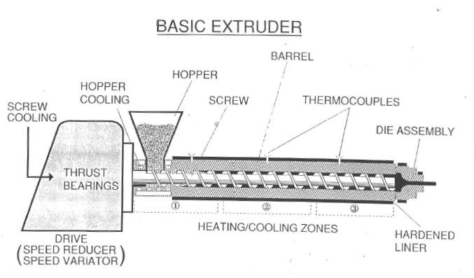

Slide 79
Wire Drawing 7.1 Introduction: In drawing, the cross section of a long rod or wire is reduced or changed by pulling (hence the term drawing) it through a die called a draw die (Fig). Thus, the difference between drawing and extrusion is that in extrusion the material is pushed through a die, whereas in drawing it is pulled through it. Although the presence of tensile stresses is obvious in drawing, compression also plays a significant role because the metal is squeezed down as it passes through the die opening. For this reason, the deformation that occurs in drawing is sometimes referred to as indirect compression. Drawing is a term also used in sheet metalworking. The term wire and bar drawing is used to distinguish the drawing process discussed here from the sheet metal process of the same name. Rod and wire products cover a very wide range of applications, including shafts for power transmission, machine and structural components, blanks for bolts and rivets, electrical wiring, cables,..Etc.

Slide 80
The major processing variables in drawing are similar to those in extrusion that is, reduction in cross-sectional area, die angle, friction along the die-workpiece interface, and drawing speed. The die angle influences the drawing force and the quality of the drawn product. The basic difference between bar drawing and wire drawing is the stock size that is processed. Bar drawing is the term used for large diameter bar and rod stock, while wire drawing applies to small diameter stock. Wire sizes down to 0.03 mm (0.001 in) are possible in wire drawing. Bar drawing is generally accomplished as a single-draft operation—the stock is pulled through one die opening. Because the beginning stock has a large diameter, it is in the form of a straight cylindrical piece rather than coiled. This limits the length of the work that can be drawn. By contrast, wire is drawn from coils consisting of several hundred (or even several thousand) feet of wire and is passed through a series of draw dies. The number of dies varies typically between 4 and 12.

Slide 81
Tube Drawing: Drawing can be used to reduce the diameter or wall thickness of seamless tubes and pipes, after the initial tubing has been produced by some other process such as extrusion. Tube drawing can be carried out either with or without a mandrel. The simplest method uses no mandrel and is used for diameter reduction, as in Figure 7.2. The term tube sinking is sometimes applied to this operation.
L_{c}

Slide 82
FASTENER
Industry Standards Most industrial fasteners are covered by two basic standards: one for materials and properties; the other, for dimensions and tolerances. Specifications for materials and properties are published by the American Society for Testing and Materials (ASTM), although other groups such as the Society of Automotive Engineers (SAE) also publish specifications covering these requirements. Standards for dimensions and tolerances are issued by the American National Standards Institute (ANSI) in cooperation with the American Society of Mechanical Engineers (ASME) and the Industrial Fasteners Institute (IFI). Where applicable, published specifications covering a particular fastener will be referenced in the section of this booklet dealing with that fastener. When referring to standards and specifications, we will use only the well-known initials of the above societies-ANSI, ASME, IFI, ASTM and SAE. Standard fasteners are basic industrial fasteners - square and hex bolts, cap screws, carriage bolts, plow bolts, lag screws, studs, nuts, rivets and others - which have been standardized over the years as to type‘, style, usage, properties, dimensions and tolerances. These include a vast range of sizes and types stocked by distributors and manufacturers for an almost limitless range of applications: the assembly and maintenance of vehicles, appliances, farm equipment, construction equipment, industrial and plant machinery of all kinds, furniture and toys. Wherever there’s a need for holding parts together, holding them apart, holding them up, or holding them down, a standard fastener can usually be found to do the job efficiently and economically. Modern industrial fasteners are manufactured to a variety of standards covering dimensions, tolerances, materials, mechanical properties, testing procedures, etc.

Slide 84
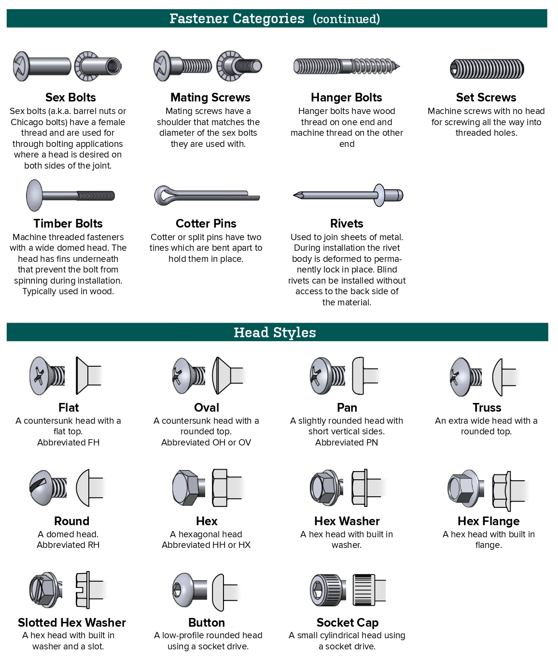

Slide 85
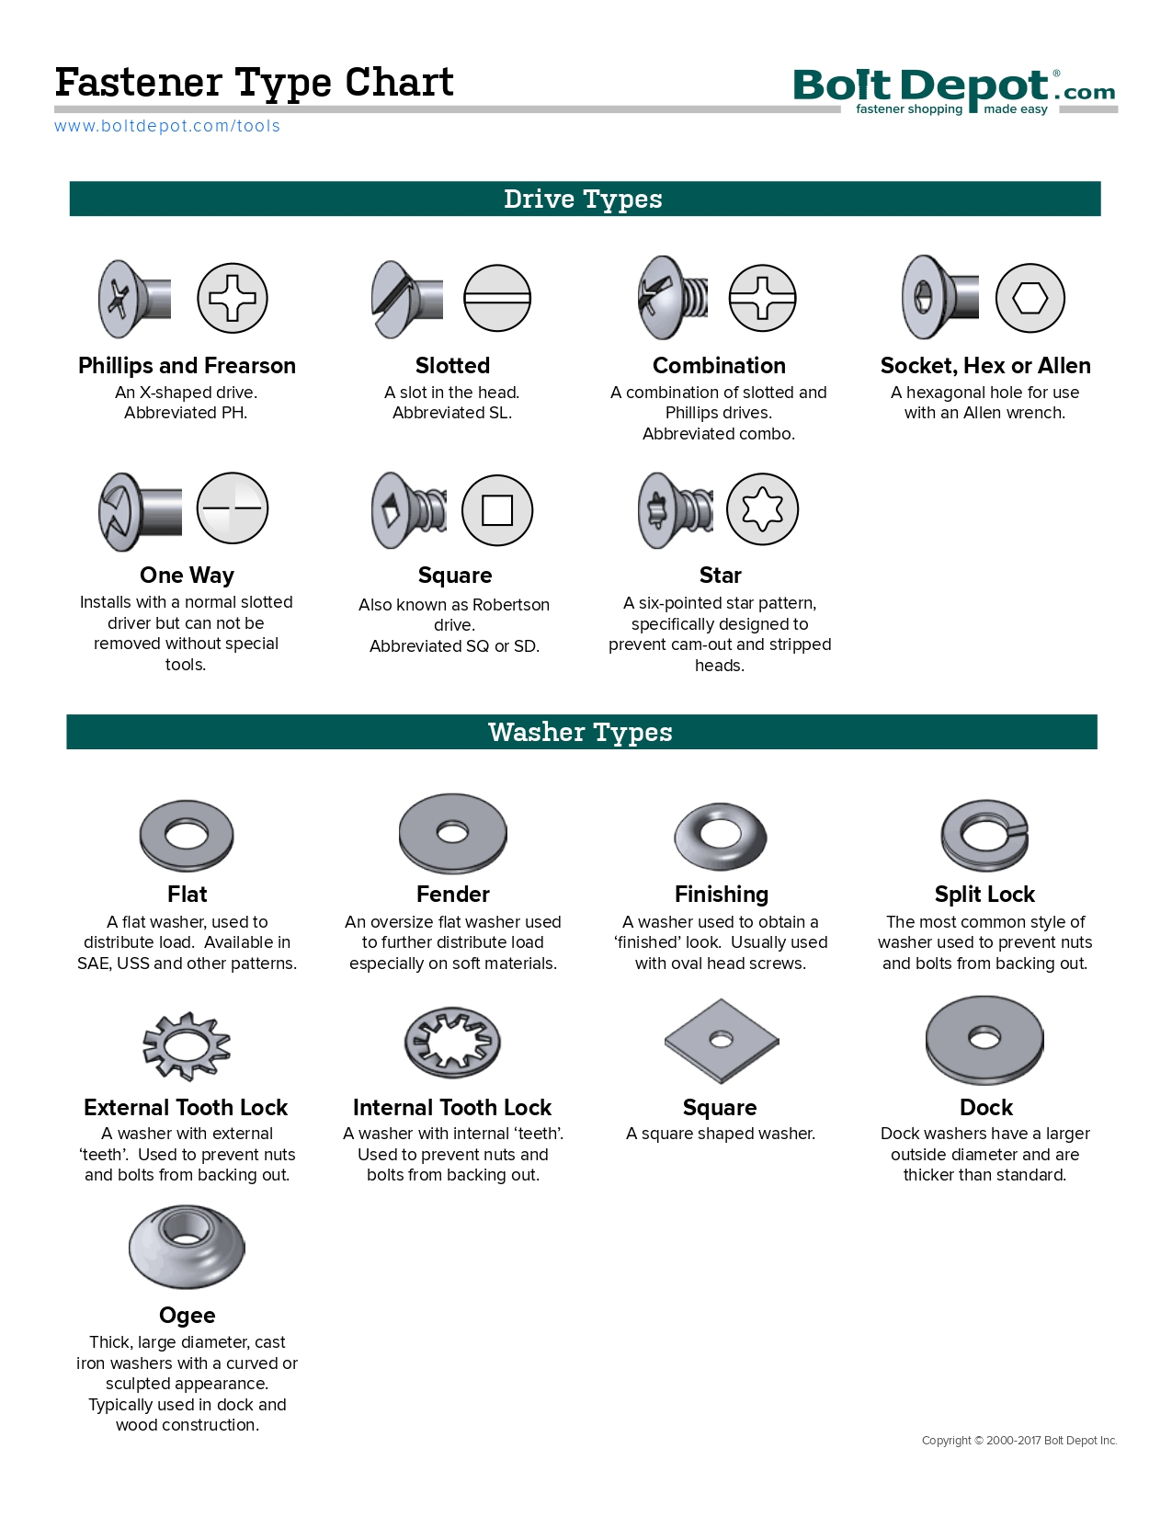

Slide 86
POWER TRANSMISSION DEVICES
The power is transmitted from one shaft to the other by means of belts, chains and gears. The belts and ropes are flexible members which are used where distance between the two shafts is large. The chains also have flexibility but they are preferred for intermediate distances. The gears are used when the shafts are very close with each other. This type of drive is also called positive drive because there is no slip. If the distance is slightly larger, chain drive can be used for making it a positive drive. Belts and ropes transmit power due to the friction between the belt or rope and the pulley. There is a possibility of slip and creep and that is why, this drive is not a positive drive. A gear train is a combination of gears which are used for transmitting motion from one shaft to another.
Objectives After studying this unit, you should be able to
• understand power transmission derives,
• understand law of belting,
• determine power transmitted by belt drive and gear,
• determine dimensions of belt for given power to be transmitted,
• understand kinematics of chain drive,
• determine gear ratio for different type of gear trains,
• classify gears, and
• understand gear terminology.

Slide 87
POWER TRANSMISSION DEVICES
Power transmission devices are very commonly used to transmit power from one shaft to another. Belts, chains and gears are used for this purpose. When the distance between the shafts is large, belts or ropes are used and for intermediate distance chains can be used. For belt drive distance can be maximum but this should not be more than ten metres for good results. Gear drive is used for short distances.
Belts In case of belts, friction between the belt and pulley is used to transmit power. In practice, there is always some amount of slip between belt and pulleys, therefore, exact velocity ratio cannot be obtained. That is why, belt drive is not a positive drive. Therefore, the belt drive is used where exact velocity ratio is not required. The following types of belts shown in Figure 3.1 are most commonly used :
Flat Belt and Pulley (b) V-belt and Pulley (c) Circular Belt or Rope Pulley Figure 3.1 : Types of Belt and Pulley

Slide 88
The flat belt is rectangular in cross-section as shown in Figure 3.1(a). The pulley for this belt is slightly crowned to prevent slip of the belt to one side. It utilises the friction between the flat surface of the belt and pulley.
The V-belt is trapezoidal in section as shown in Figure 3.1(b). It utilizes the force of friction between the inclined sides of the belt and pulley. They are preferred when distance is comparative shorter. Several V-belts can also be used together if power transmitted is more.
The circular belt or rope is circular in section as shown in Figure 8.1(c). Several ropes also can be used together to transmit more power.
The belt drives are of the following types :
open belt drive, and
cross belt drive.

Slide 89
Open Belt Drive
Open belt drive is used when sense of rotation of both the pulleys is same. It is desirable to keep the tight side of the belt on the lower side and slack side at the
top to increase the angle of contact on the pulleys. This type of drive is shown in Figure 3.2.
Slack Side _{Thickness}
Slack Side _{Thickness}
Slack Side _{Thickness}
Slack Side _{Thickness}
Effective Radius
Tight Side
Neutral Section

Slide 90
Cross Belt Drive
In case of cross belt drive, the pulleys rotate in the opposite direction. The angle of contact of belt on both the pulleys is equal. This drive is shown in Figure 3.3. As shown in the figure, the belt has to bend in two different planes. As a result of this, belt wears very fast and therefore, this type of drive is not preferred for power transmission. This can be used for transmission of speed at low power.
Since power transmitted by a belt drive is due to the friction, belt drive is subjected to slip and creep.

Slide 91
Chain
The belt drive is not a positive drive because of creep and slip. The chain drive is a positive drive. Like belts, chains can be used for larger centre distances. They are made of metal and due to this chain is heavier than the belt but they are flexible like belts. It also requires lubrication from time to time. The lubricant prevents chain from rusting and reduces wear.
The chain and chain drive are shown in Figure 3.4. The sprockets are used in place of pulleys. The projected teeth of sprockets fit in the recesses of the chain. The distance between roller centers of two adjacent links is known as pitch. The circle passing through the pitch centers is called pitch circle.

Slide 92
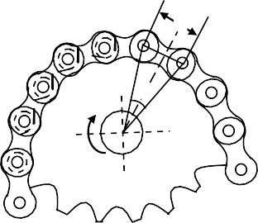
Roller Bushing
Pin Pitch
Pitch
Figure 3.4 : Chain and Chain Drive

Slide 93
Gears
Gears are also used for power transmission. This is accomplished by the successive engagement of teeth. The two gears transmit motion by the direct contact like chain drive. Gears also provide positive drive.
The drive between the two gears can be represented by using plain cylinders or discs 1 and 2 having diameters equal to their pitch circles as shown in Figure 3.5. The point of contact of the two pitch surfaces shell have velocity along the common tangent. Because there is no slip, definite motion of gear 1 can be transmitted to gear 2 or vice-versa.
The tangential velocity ‘V_{p}’ = ω₁ r₁ = ω₂ r₂
where r₁ and r₂ are pitch circle radii of gears 1 and 2, respectively.
Gear Drive

Slide 94
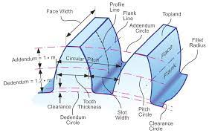

Slide 95
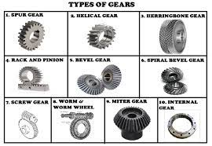

Slide 96
Pressure recording
Ideal ambient conditions require reliable control. In a variety of conditions, the instruments help to measure and document pressure, temperature and other characteristics, such as humidity. The appropriate pressure data loggers have the relevant sensors and some of them are equipped for additional temperature and humidity probes. In terms of recording, some instruments have an integrated data monitoring system, while others can be connected to a PC to enable data collection. WiFi data loggers or models with a cable connection come into consideration here. The appropriate software for data readout on the computer is available in three versions and is easy to download.

Slide 97
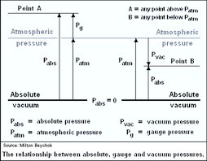

Slide 98
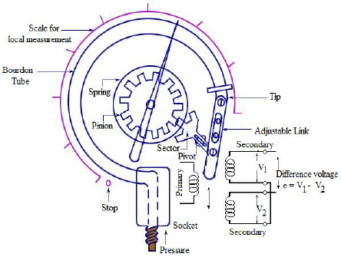

Slide 99
